Slide 1
Blockchain
Ethereum ecosystem
4 March2021

Slide 2
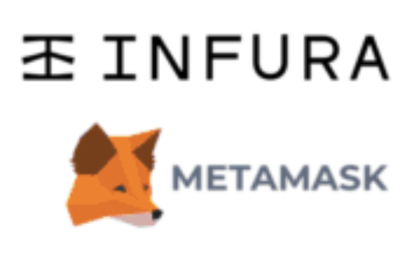
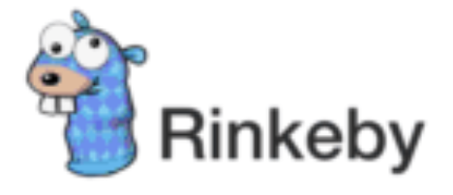
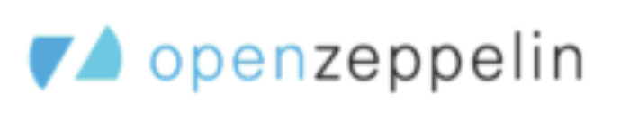


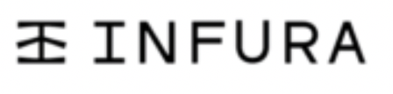
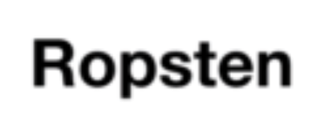
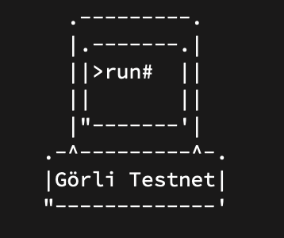
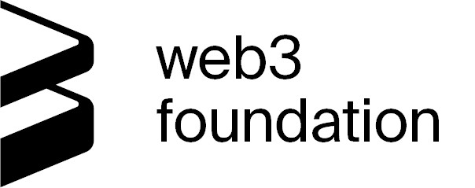


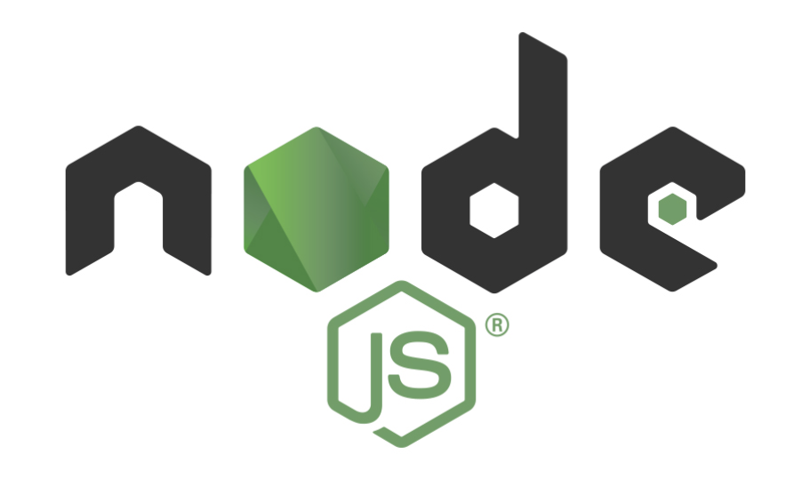



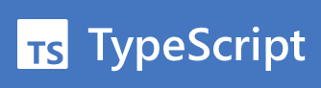
Infrastructure
Network Testing
Frameworks
Security Audits
Interface
Development
Kovan
Ethereum ecosystem |

Slide 3
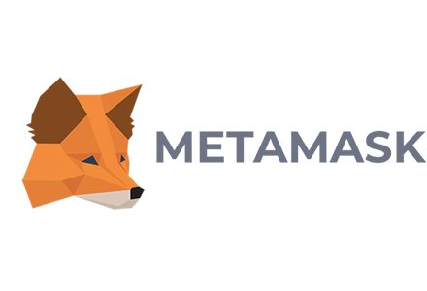




+
Interface between the browser (Web3) and dApps
Holds Ethereum wallet information
Ecosystem technologies and providers
Open source Solidity Contract libraries
Security Audits (service)
+
Collection of tools for smart contracts interaction and deployment.
Ganache as a local Ethereum box
Ethereum technology and providers |

Slide 4
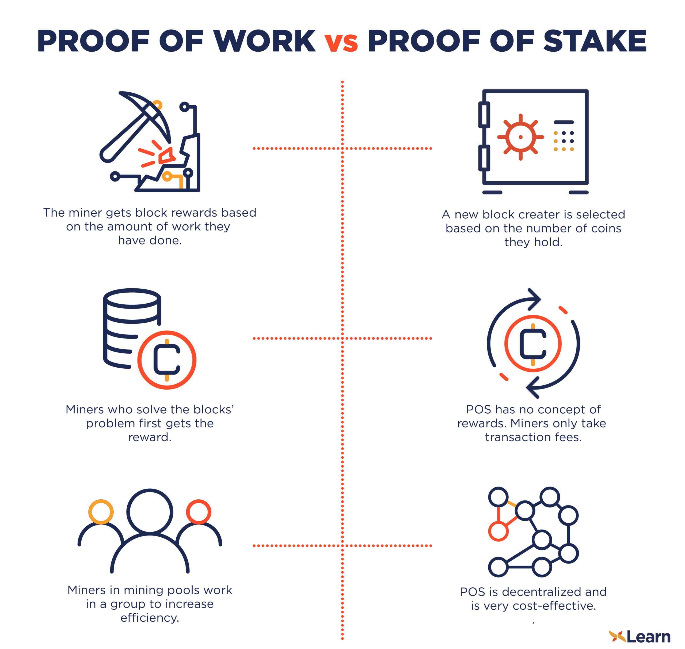
Ethereum PoS vs PoW

Slide 5
Demo
Claim Technology |

